Slide 1
PowerApps & Flow
Ray Hogan
@rayhogan

Slide 2
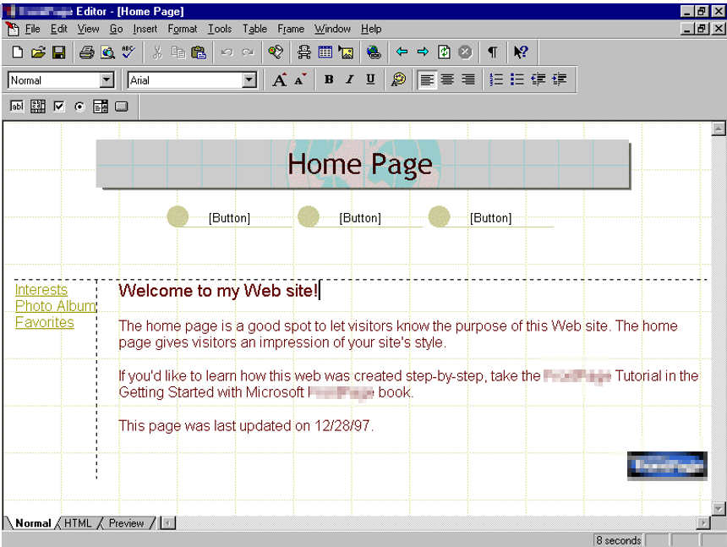
Notes:
My first exposure to a No Code development tool by Microsoft was this. Does anyone know what this is?

Slide 3
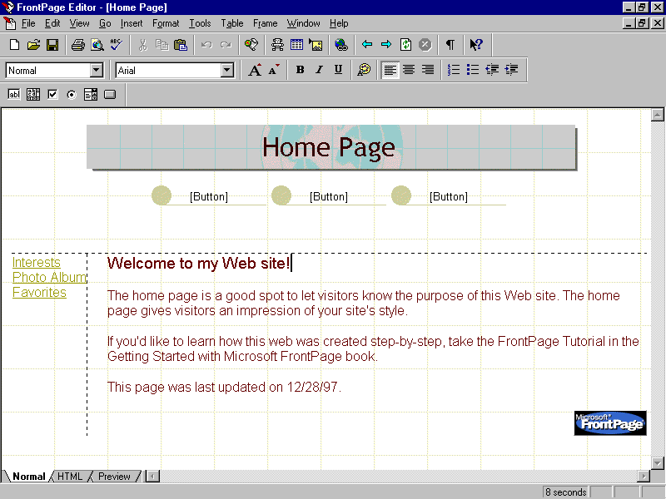
Notes:
This is Microsoft Frontpage. A drag and drop web development tool that was packaged with Windows 98. This was a tool that allowed you to create web pages as if you were writing a word document, and as a 10 year old I had lots of fun creating pages and then looking to see the corresponding HTML that was generated behind it. And slowly by doing this I was able to painstakingly learn HTML. Today, Frontpage is no more but instead I’m having fun with some of their newer more sophisticated drag and drop tools.

Slide 4
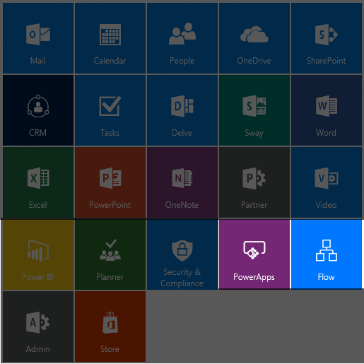

Slide 5


Drag & Drop Workflow Builder
Run on Triggers or Schedule
Integrated Templates
View Run Instances of Flows
…
Drag & Drop App Builder
Data Connectors
CRUD Capabilities
Mobile App
Template Driven
…

Slide 6





Advantages of “No Code” Development
Browser Based
Quick Implementation
Visualization
Low Entry Level
Fun!

Slide 7



Backend Data Source
End User Form
Automated Approval Workflow

Slide 8

Let’s Get Stuck In!

